Slide 2
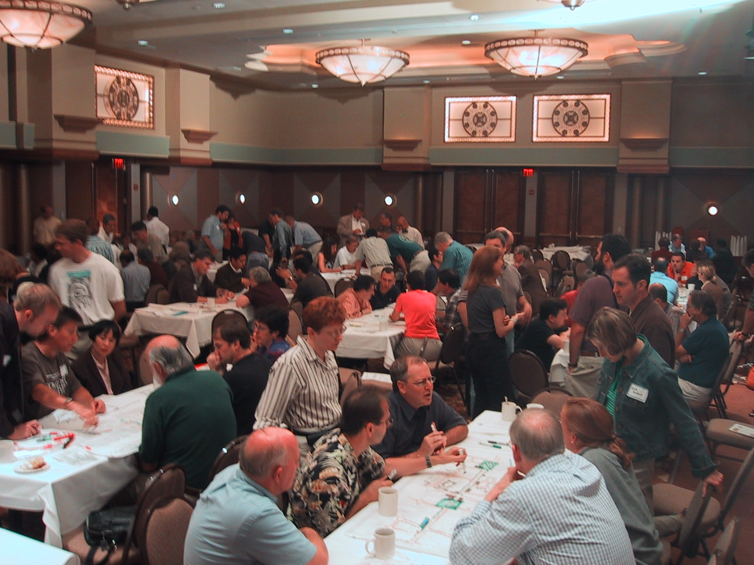
southeast florida’s regional vision
for economic prosperity
the blueprint
outreach
teamwork
experts

Slide 3
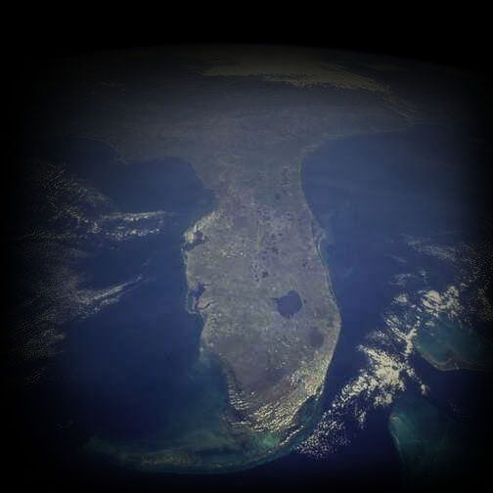
Florida will grow at twice the rate as the United States as a whole.
Florida will represent 9.5% of future national population growth and 8.0% of future national employment growth.
Southeast Florida will represent 31.5% of future statewide population growth and 31.7% of future statewide employment growth.
Palm Beach, Broward and Miami-Dade will represent 85% of future growth of the region.

Slide 4
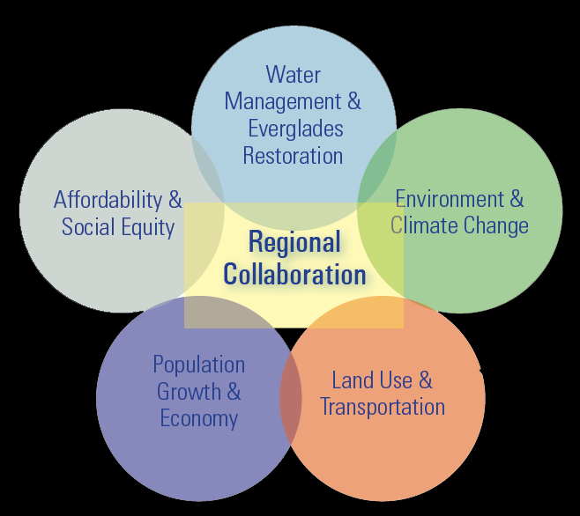
How and where will we provide workforce and affordable housing?
How can we reduce housing, insurance and transportation costs?
How can we expedite everglades restoration?
Can we provide water resources for growth?
How can we align our regional efforts and adapt institutions?
What actions will reduce greenhouse emissions?
Are there steps we can take that will make us safer from future storms?
How can we reduce congestion?
What types of transportation systems should we invest in?
How to balance movement of goods and people?
How and where will we grow?
Which industrial centers will define our economy?
Southeast Florida 2060 - SFRPC, TCRPC, FAU (and others) 2008
Notes:
…. to continue the regional dialogue like that described in Southeast Florida 2060

Slide 5
2012
2013
2014
Q 1
Q 2
Q 3
Q 4
Q 1
Q 2
Q 3
Q 4
Q 1
Task 1: Building Collaborative Partnerships
Task 2: Regional Resource Library and Scorecard
February 2014
Task 3: Conducting Public Engagement
Task 4: Enhancing Regional Leadership and Technical Capacity
Task 5: Developing Regional Vision
Task 6: Developing Blueprint
& Implementation
Primary Tasks

Slide 6
2012
2013
2014
Q 1
Q 2
Q 3
Q 4
Q 1
Q 2
Q 3
Q 4
Q 1
Task 1: Building Collaborative Partnerships
1.1 Continue Developing Regional Partnership
February 2014
1.2 Identify Opportunities to Enhance Collaboration
1.3 State and Regional Coordination
1.4 Strategies for Regional Collaboration
1.5 Expand Participation
1.7 Continue Developing Regional Partnership
Task 1 items are being performed by the RPCs

Slide 7
2012
2013
2014
Q 1
Q 2
Q 3
Q 4
Q 1
Q 2
Q 3
Q 4
Q 1
Task 2: Regional Resource Library and Scorecard
2.1 National Research
2.2 Survey and Integrate Regional Values
2.3 Data Warehouse
February 2014
2.4 Demographic Forecasts
2.5 Regional Housing Assessment
2.6 Virtual Present
2.7 Existing Conditions Analysis and Modeling
2.8 Trend Future
2.9 Model Trend
2.10 Develop Regional Indicators for Scorecard
2.11 Select Indicators for Scorecard, Review w/ Exec. Committee
2.12 Integrate Scorecard Indicators in Model
2.13 Ongoing Monitoring

Slide 8
2012
2013
2014
Q 1
Q 2
Q 3
Q 4
Q 1
Q 2
Q 3
Q 4
Q 1
Task 3: Conducting Public Engagement
3.1 Create Outreach & Engagement Strategy
February 2014
3.2 Refine & Implement Outreach Strategy
3.3 Web Site & Template Materials (including Regional Scorecard)
3.4 Regional Values Polling
3.5 Regional Scenario Workshops & Summits
Regional Summit – Peer Regions
Regional Summit – Existing Conditions and Trend Future
Regional Summit - Where Do We Want To Go?
Regional Summit – Preferred Scenario - How Do We Get There?
Regional Summit – Regional Vision Adoption
3.6 Develop a Speakers Bureau

Slide 9
2012
2013
2014
Q 1
Q 2
Q 3
Q 4
Q 1
Q 2
Q 3
Q 4
Q 1
Task 4: Enhancing Regional Leadership and Technical Capacity
4.1 Develop Capacity-Building Strategy
February 2014
4.2 Asset Mapping
4.3 Develop Regional Leadership Program
4.4 Best Practices
Task 4 items are part of the Public Engagement Phase

Slide 10
2012
2013
2014
Q 1
Q 2
Q 3
Q 4
Q 1
Q 2
Q 3
Q 4
Q 1
Task 5: Developing Regional Vision
5.1 Develop Workshop Framework and Content
5.2 Workshop Training w/ Partners
February 2014
5.3 Regional Workshops
5.4 Compile & Analyze Workshops Results
5.5 Create Alternative Future Scenarios
5.6 Evaluate Model Scenarios, Present Findings
5.7 Outreach Program and Regional Dialogue
5.8 Choose and Model Preferred Scenario
5.9 Create Vision Plan
Task 5

Slide 11
2012
2013
2014
Q 1
Q 2
Q 3
Q 4
Q 1
Q 2
Q 3
Q 4
Q 1
Task 6: Developing Blueprint
& Implementation
6.1 Develop Vision Framework
6.2 Develop Blueprint Integration Strategy
February 2014
6.3 Identify Paths to Implementation
6.4 Vision Adoption
6.5 Integrate Regional Blueprint into Strategic Planning
6.6 Identify, Scope & Implement Demonstration Projects
6.7 Create a Regional Tool Box
6.8 Refine and Update Regional Blueprint
Task 6

Slide 12
Dover, Kohl & Partners
Citizen-Based Regional Planning & Visioning
Duany Plater-Zyberk & Company
Planning, Policy, Modeling Tools
Criterion Planners
Scenario Modeling and Implementation
Robert Burchell, PhD, Rutgers
Economic Analysis
Strategic Economics
TOD Strategies
The Brookings Institution
Economic Advisory Panel
Cardno ENTRIX
Enviro Economics, Ecology, Sustainability & Climate Change
Cardno TBE
Brownfield Redevelopment
HDR
Transportation & Infrastructure
Hall Planning & Engineering
Multi-modal Transportation
Crowdbrite
Online Idea Collaboration
Gorman & Associates
Housing Strategy
Emerge Consulting
Public Outreach
Spikowski Planning Associates
Model Ordinances
Paul Vrooman, University of Miami
Public Education
Municipal Code Corporation
Code Integration
Notes:
Tour team was chosen with three goals in mind: increase global/national economic competitiveness; increase housing supply/affordability; and prepare for climate change/sea level rise.

Slide 13
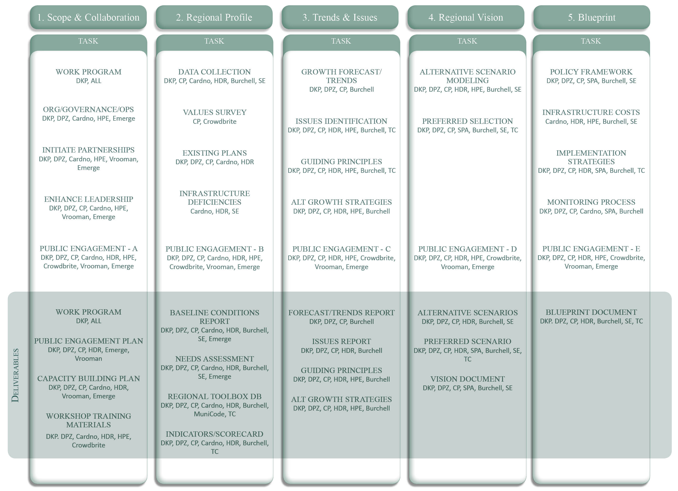
Notes:
We have a work plan we have refined further since the submittal of the SOQ which we can come back to and discuss later. Suffice to say we have a plan for every task…
This is just a rough outline and we look forward to working with the committee on this

Slide 14
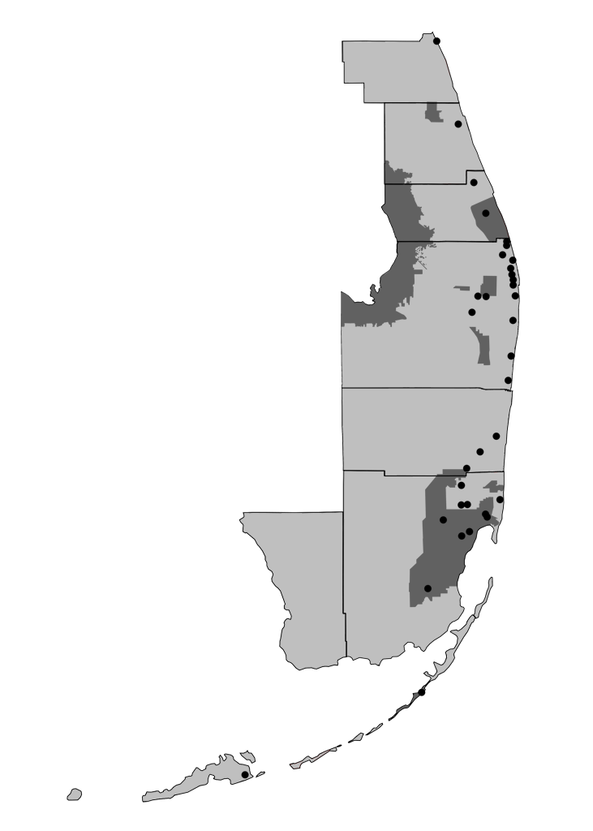
Dover-Kohl
& DPZ
Windsor, Indian River County
Towns, Villages, and Countryside Land Development Regulations, St. Lucie County
Fort Pierce Waterfront & Corridor Plan
Downtown Stuart
South Martin County Regional Plan
Waterfront Quarter, Jupiter
Abacoa, Jupiter
Lake Okeechobee Regional Plan
Seven Cities - The U.S. 1 Corridor, Palm Beach County
Water Preserve Areas, TCRPC
Downtown Lake Worth Plan, TCRPC
Fox Property Study, TCRPC
Callery Judge Grove, Loxahatchee
Wellington, Palm Beach County
PBC Agricultural Reserve
West Palm Beach Downtown Plan
Royal Palm Beach Corridor Plan
North Federal Corridor, Delray Beach
Charleston Place, Boca Raton
Davie Downtown Plan
Mirabella, Miramar
Western C-9 Basin, Miami-Dade & Broward Counties
Lake Belt Plan, Miami-Dade County
Miami Lakes Town Center
North Miami Beach Bicycle Masterplan
Aqua, Miami Beach
Miami Springs Downtown Plan
Downtown Doral
Miami 21
UM Miller School of Medicine, Miami
Miami-Dade County TND Ordinance
Miami-Dade County Agricultural & Rural Area Study
South Miami Hometown Plan
Downtown Kendall
Downtown Homestead Action Plan
Bluewater Carpet Cottages, Tavernier
30+ years local experience
50+ SE Florida projects
Notes:
Regional planning typically has no clear constituency with the exception of large regional organizations.
A constituency must be built. We have excellent relationships with every one of our clients public and private. They, along with our friends and classmates, are the leadership of South Florida. The people we have worked with will want to be part of this process, they will take ownership, identify with the plan, and add its goals and objectives to their work.

Slide 15
Notes:
… form the national cannon on planning.

Slide 16
Notes:
… form the national cannon on planning.

Slide 17
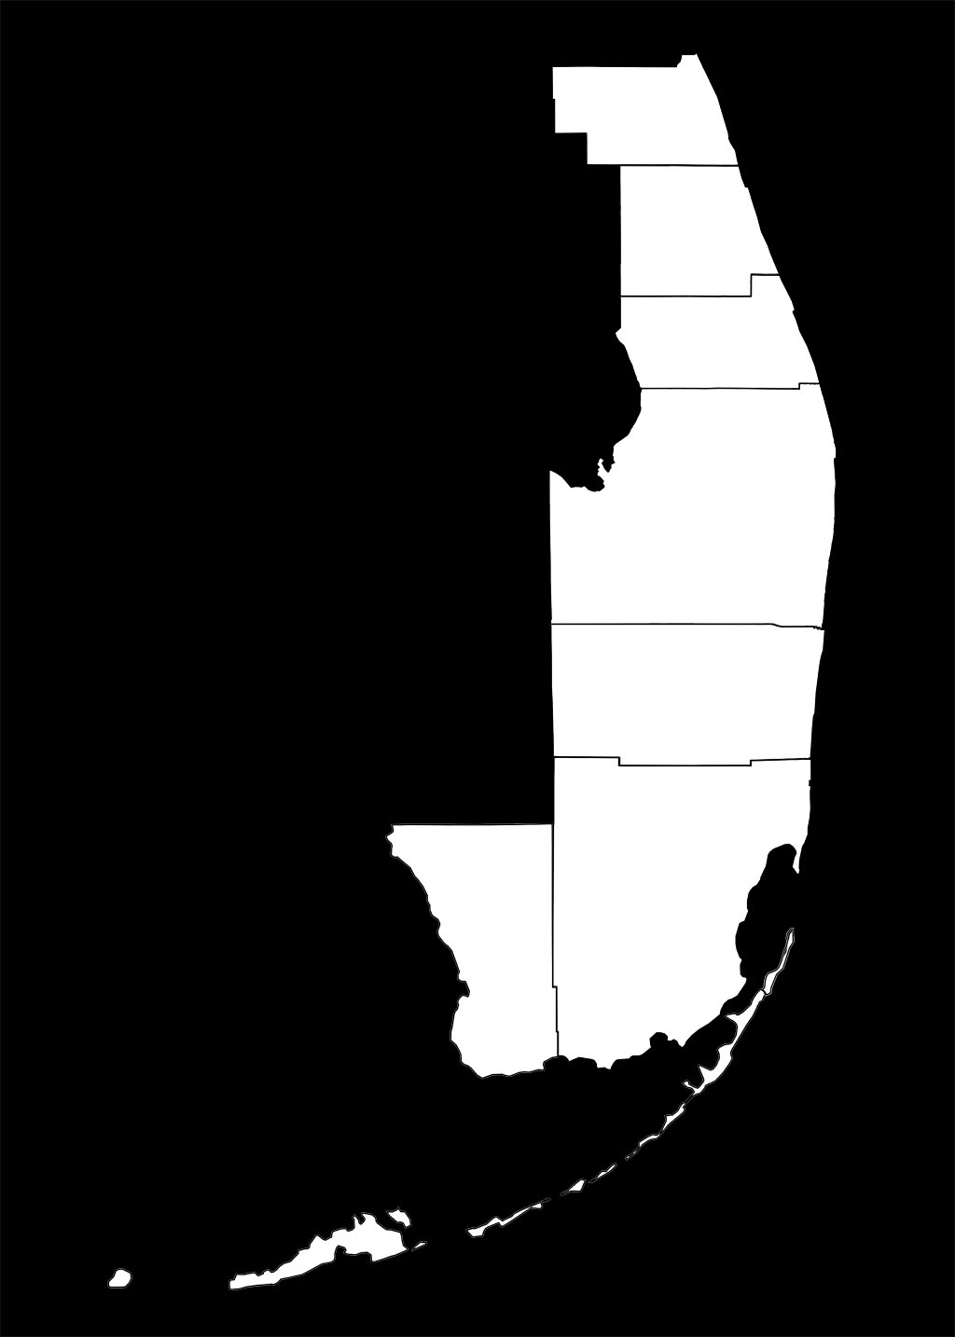
design at all scales
Notes:
Design at all scales, to design at the scale of the region is more zoomed out than Burnham’s Plan for Chicago, L’Enfant’s plan for DC.
Here’s a sample of the type of mapping which could be produced for all the counties in the partnership. There was no client, we did this as interested citizens and residents of South Florida.

Slide 18
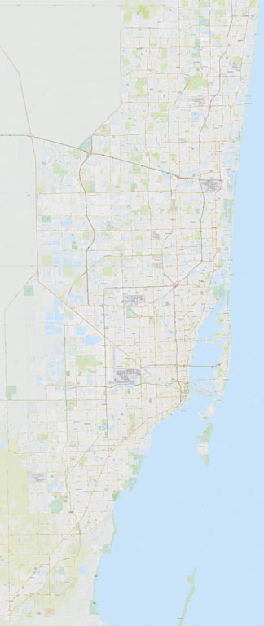
Today
Notes:
Design at all scales, to design at the scale of the region is more zoomed out than Burnham’s Plan for Chicago, L’Enfant’s plan for DC.
Here’s a sample of the type of mapping which could be produced for all the counties in the partnership. There was no client, we did this as interested citizens and residents of South Florida.

Slide 19
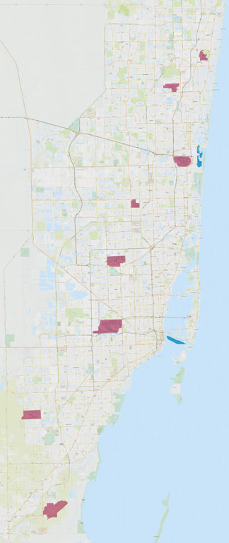
Today
Airports
Seaports
Notes:
First take stock of the work you’ve done. The achievements thus far.
More flights leave Miami International Airport for the Caribbean and South America than any other airport (from Preserving Paradise 2008). This gives Miami the knickname “the Capital of South America”. There is truth to this, but more than that it is a hub for the convergence of South American and Caribbean cultures.
Our passenger and freight hubs, the airports and seaports, and major economic engines of the region. The ports that are working to become docking facilities for super freighters that will bypass west coast ports (skip the overland trucking routes) and travel a widened Panama Canal.

Slide 20
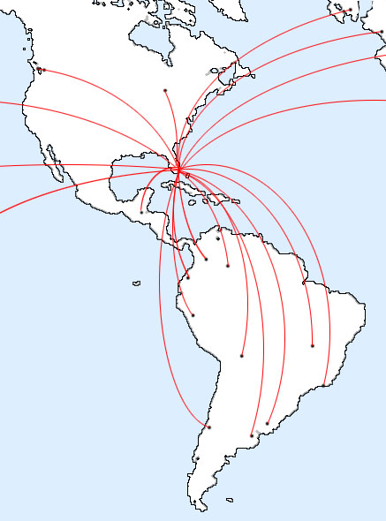
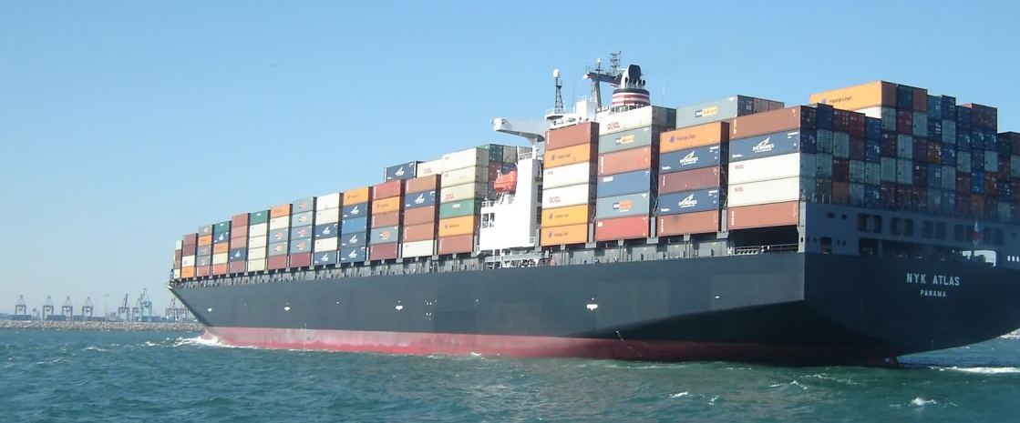
Today
Airports
Seaports
Notes:
First take stock of the work you’ve done. The achievements thus far.
More flights leave Miami International Airport for the Caribbean and South America than any other airport (from Preserving Paradise 2008). This gives Miami the knickname “the Capital of South America”. There is truth to this, but more than that it is a hub for the convergence of South American and Caribbean cultures.
Our passenger and freight hubs, the airports and seaports, and major economic engines of the region. The ports that are working to become docking facilities for super freighters that will bypass west coast ports (skip the overland trucking routes) and travel a widened Panama Canal.

Slide 21
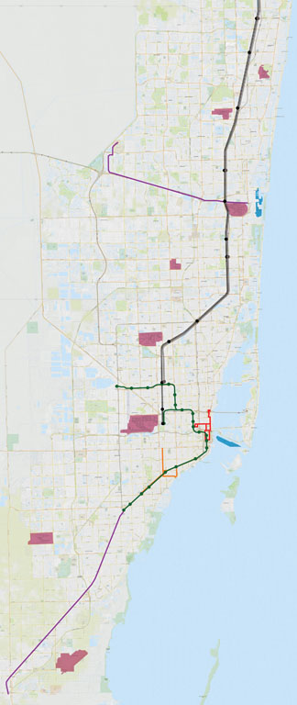
Today
Airports
Seaports
Amtrak
Tri-Rail
Metrorail
BRT & Circulators
Notes:
Map existing and imminent premium transit service.
Bus system not shown

Slide 22
Today Tomorrow
Airports
Seaports
Amtrak
Tri-Rail
Metrorail
BRT & Circulators
Notes:
Go further, imagine the future. What if…
Notice the current conditions on the left, compared to the map at the right, which shows the where we need to head in order to make automobiles less necessary. The multi-county area can be considered as one comprehensive system by virtue of the linear order of our coastal community.

Slide 23
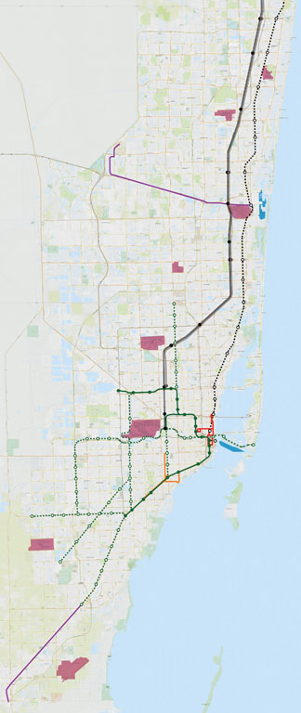
Today Tomorrow
Airports
Seaports
Amtrak
Tri-Rail
Metrorail
BRT & Circulators
Proposed FEC Passenger Rail
Proposed Passenger Rail
Notes:
First round of improvements include completing our urban rail system such as Metrorail and FEC corridor.

Slide 24
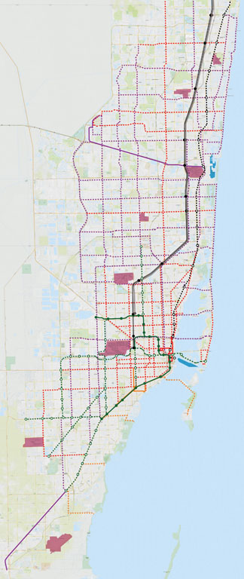
Today Tomorrow
Airports
Seaports
Amtrak
Tri-Rail
Metrorail
BRT & Circulators
Proposed FEC Passenger Rail
Proposed Passenger Rail
Proposed Streetcar or Light Rail
Proposed BRT or Express Bus
Proposed Trolley
Notes:
Support these with other premium transit upgrades such as light rail, street car, and bus rapid transit, to get us off of the perpetual treadmill of highway expansion and worsening air quality.

Slide 25
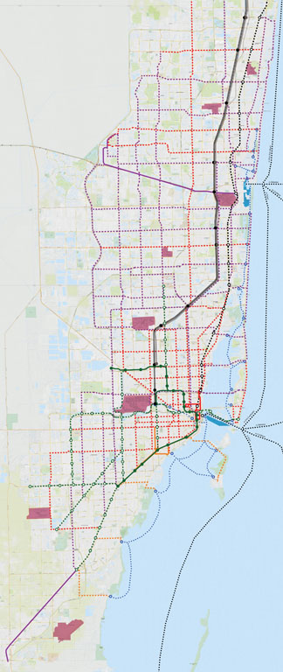
Today Tomorrow
Airports
Seaports
Amtrak
Tri-Rail
Metrorail
BRT & Circulators
Proposed FEC Passenger Rail
Proposed Passenger Rail
Proposed Streetcar or Light Rail
Proposed BRT or Express Bus
Proposed Trolley
Existing & Proposed Water Taxi
Proposed Ferry
Notes:
Getting serious about using water-born transit (ferries, hydrofoils, water taxis) to acknowledge that our region is defined by water, and we once had a highly evolved transit web which connected water travel to land travel in a seamless way, both for freight and passengers. We can once again tap into a greater circle of economic partners such as our island neighbors, including the Florida Keys, the Bahamas, and the further afield.

Slide 26
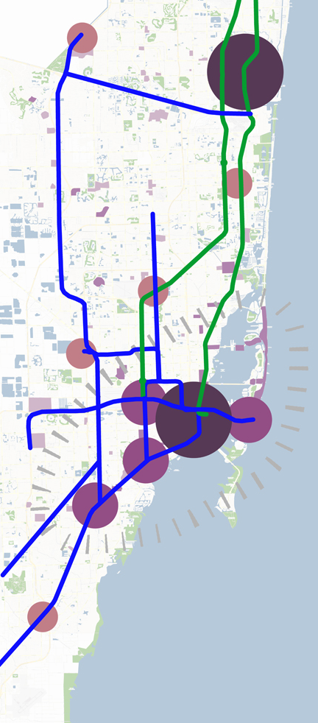
Notes:
But to do this well, for it to be worth our time what we need is not just coarse-grained bullseyes and vectors. We need a regional vision which leaps back and forth across different scales, and a team which is courageous enough to confront the specifics of the regional infrastructure and land use patterns and is equipped to answer questions such as “where should the precise alignments of transit routes and stations be located?”

Slide 27
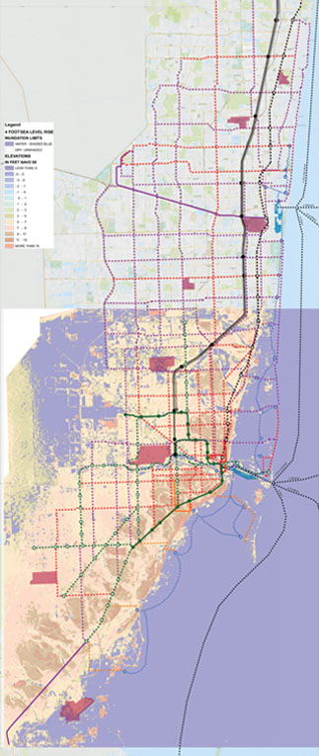
Today Tomorrow?
Airports
Seaports
Amtrak
Tri-Rail
Metrorail
BRT & Circulators
Proposed FEC Passenger Rail
Proposed Passenger Rail
Proposed Streetcar or Light Rail
Proposed BRT or Express Bus
Proposed Trolley
Existing & Proposed Water Taxi
Proposed Ferry
Notes:
Getting serious about using water-born transit (ferries, hydrofoils, water taxis) to acknowledge that our region is defined by water, and we once had a highly evolved transit web which connected water travel to land travel in a seamless way, both for freight and passengers. We can once again tap into a greater circle of economic partners such as our island neighbors, including the Florida Keys, the Bahamas, and the further afield.

Slide 28
southeast florida’s regional vision
for economic prosperity
the blueprint
outreach
teamwork
experts

