Slide 1
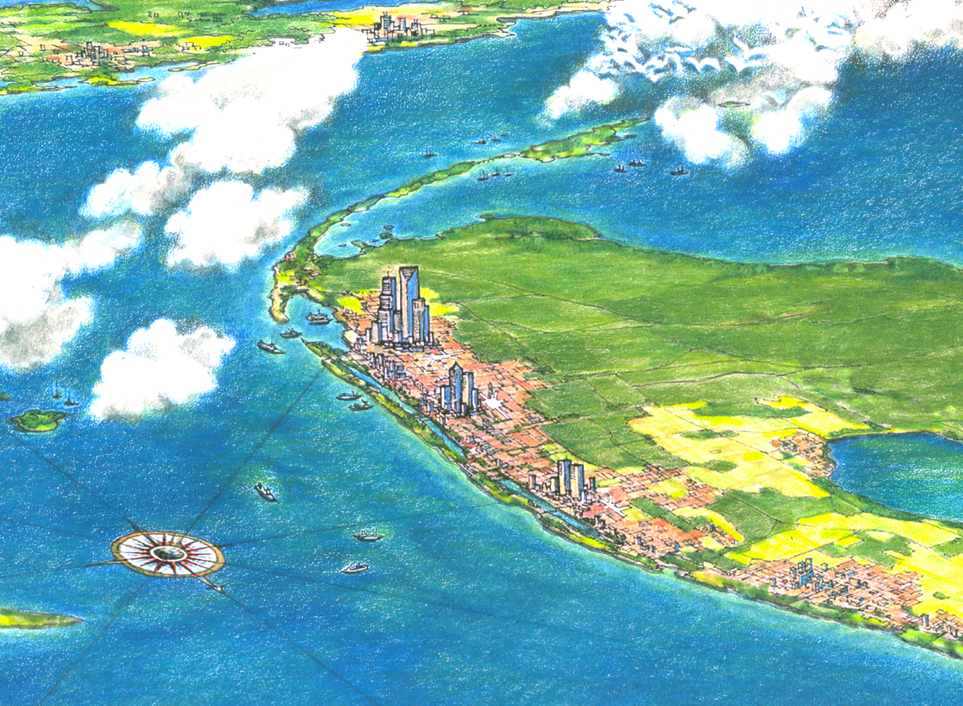
Southeast Florida’s Regional Vision
for Economic Prosperity
the blueprint
Transportation Challenges and
Opportunities in SE Florida

Slide 2
Transportation in SE Florida:
Challenges and Opportunities
Multiple Planning Agencies
Freight & Goods Distribution: Rail, Ports, Inland Ports and SIS Systems
Commuter Rail: SFECC (FDOT) & NEW START (SFRTA)
Transit
Connecting LAND USE and TRANSPORTATION
Sea Level Rise
High Speed Rail

Slide 3
Agencies with Planning Responsibilities
MPOs & TPOs
Miami-Dade
Broward
Palm Beach
Martin
St. Lucie
Indian River
Public Sector Operators
Miami-Dade Transit
Broward County Transit
Palm Tran
SFRTA/Tri-Rail
FDOT
Turnpike Enterprise
Rail Enterprise
Miami-Dade
Expressway Authority
Martin Council on Aging
St Lucie Council on Aging
Indian River GoLine
Ports
Airports
State, Regional & Local
State:
Region:
Local:
FDOT, DCA
SFRPC & TCRPC
County &municipalities

Slide 4
Agencies with Planning Responsibilities
MPOs & TPOs
Miami-Dade
Broward
Palm Beach
Martin
St. Lucie
Indian River
23 Transportation Planning Agencies,
7 Counties and
121
Towns and Cities
Public Sector Operators
Miami-Dade Transit
Broward County Transit
Palm Tran
SFRTA/Tri-Rail
FDOT
Turnpike Enterprise
Rail Enterprise
Miami-Dade
Expressway Authority
Martin Council on Aging
St Lucie Council on Aging
Indian River GoLine
Ports
Airports
State, Regional & Local
State:
Region:
Local:
FDOT, DCA
SFRPC & TCRPC
County &municipalities

Slide 5
The “Lay of the Land”
Monroe
Miami-Dade
Broward
Palm Beach
Martin
Saint Lucie
Indian River
Miami Urbanized Area
Port St. Lucie UA
Vero UA
MPO
MPO
MPO
MPO
TPO
MPO
Southeast Florida Transportation Council (SEFTC)
Treasure Coast Transportation Council
FDOT District VI
FDOT District IV
Rail Enterprise
Turnpike Enterprise
South Florida Regional Transportation Authority/Tri-Rail
Martin/St. Lucie
RTO
MDT
BCT
Palm Tran
MC Council on Aging
SLC Council on Aging
GoLine IRT
MDX
South Florida RPC
Treasure Coast Regional Planning Council
Local Governments

Slide 6
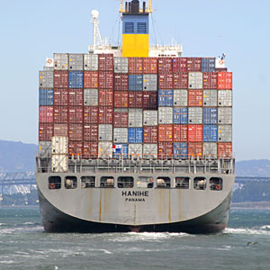
Freight and Goods
Increase Global Commerce
Notes:
A more robust system of railIf we want to expand capacity, we need to get goods to rail, intermodal facilities, and ports and airports.

Slide 7
Freight and Goods
The Challenge…
80% of all goods IN and OUT of Florida are moved by truck. (We have limited highway capacity, (this trend is NOT SUSTAINABLE).
Notes:
A more robust system of railIf we want to expand capacity, we need to get goods to rail, intermodal facilities, and ports and airports.

Slide 8
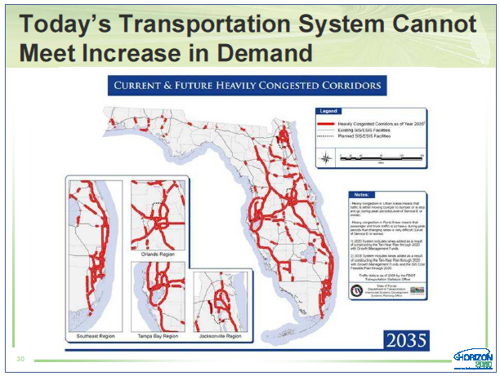

Slide 9
Other Challenges…
Our Ports have limited land side capacity and depth.
Other US Port competition for the Panamax freighters
Our Coastal Rail Lines have limited capacity to handle the
increased freight AND passenger service that is expected
to increase in the future.
… A More Robust, Interconnected, Intermodal Transportation System is Needed
Notes:
A more robust system of railIf we want to expand capacity, we need to get goods to rail, intermodal facilities, and ports and airports.

Slide 10
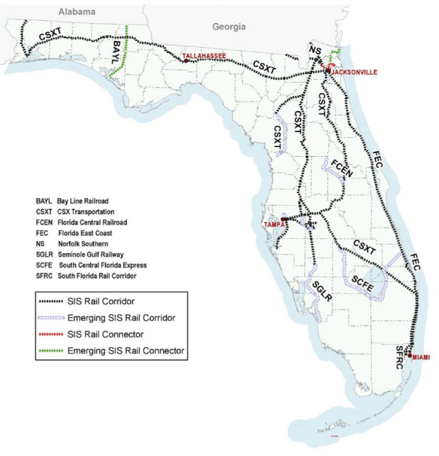
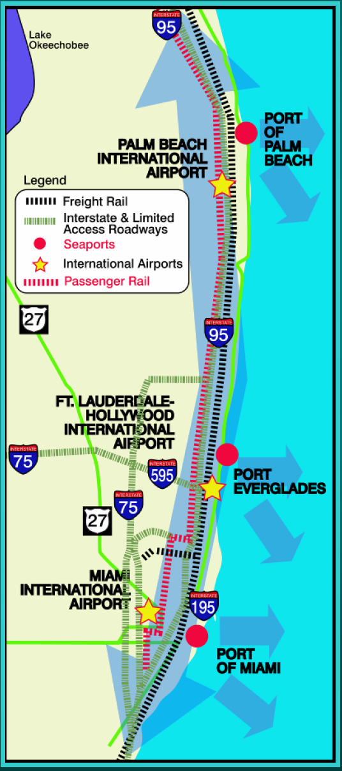
Rail: Freight Corridors and Connectors
Goal: To Increase Freight and Goods transportation capacity and enhance the integration of freight into the existing Transportation System.

Slide 11
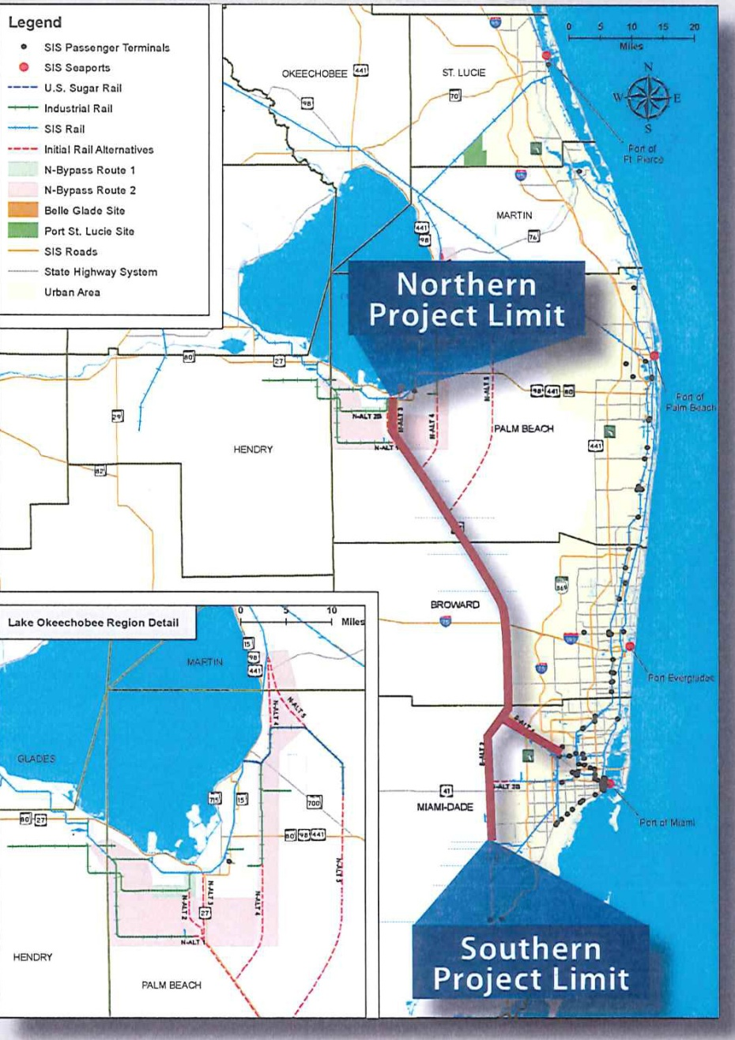
FDOT Planning related to South Florida Intermodal Logistics Center (continued)
Rail: Proposed Rail
(Multimodal Corridor)
US 27 Planning and Conceptual Engineering Study Investigate the technical and economic feasibility of developing the US-27 corridor to accommodate multimodal options, including rail and highway modes of transportation.
US-27 to accommodate future regional travel demand, in a manner consistent with Strategic Intermodal System (SIS) highway standards.
Insert graphic

Slide 12

Ports: SE Florida Port System
Port of Fort Pierce
Port of Palm Beach
 | Major Cargo Gateway Port (Deep Draft) | Gateway for non-Florida commodities Gateway for strategic Florida commodities: containers, petroleum, coal, aggregates, etc. Very strong truck, rail, barge connectivity
 | Regional Cargo Gateway Port | Gateway for regional commodities Special services, niche commodities Effective truck, rail, barge connectivity
 | Major Cruise (>1,000,000 /yr) | Strong auto/transit/air connectivity Strong truck connectivity for provisioning
Port of Ft. Lauderdale
Port of Miami
Port of Key West

Slide 13
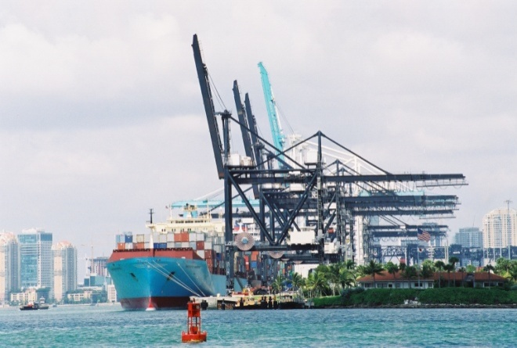
Ports: SE Florida Port System
Port of Miami
Port Tunnel
  Construction underway to connect the Port with I-395
On-Port Rail
  Re-construction of on-port rail and repair of bridge funded by Tiger II Grant
  FEC Railway funding line improvements connecting to Hialeah intermodal yard
  Flagler working to develop inland port in western Miami-Dade County to serve the Port
Deep Dredging
  Dredging to 50 feet approved
  and fully funded
  Governor Scott allocated final
  funding in March 2011

Slide 14
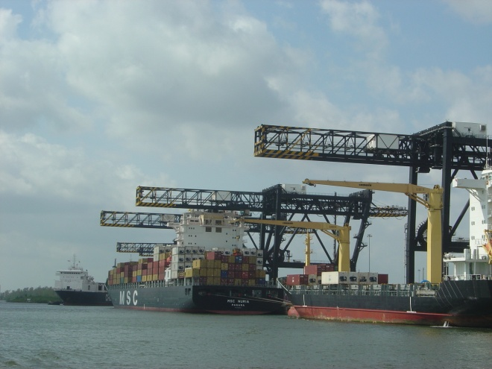
Ports: SE Florida Port System
Port Everglades
On-Port ICTF Development
  Port Everglades is developing an
  on-port ICTF in its Southport
  complex
  This will eliminate existing dray
  movements to FEC’s Fort
  Lauderdale and Hialeah
  intermodal ramps.
  Operational by 2014.
South Turning Notch Expansion
  Port Everglades is expanding its turning notch to address navigational and berthing limits for large post-panamax vessels
Deep Dredging
  Port Everglades is pursuing approval from the USACE to dredge to - 50 feet
  If approved the deepening could be completed by 2017, if fully funded

Slide 15
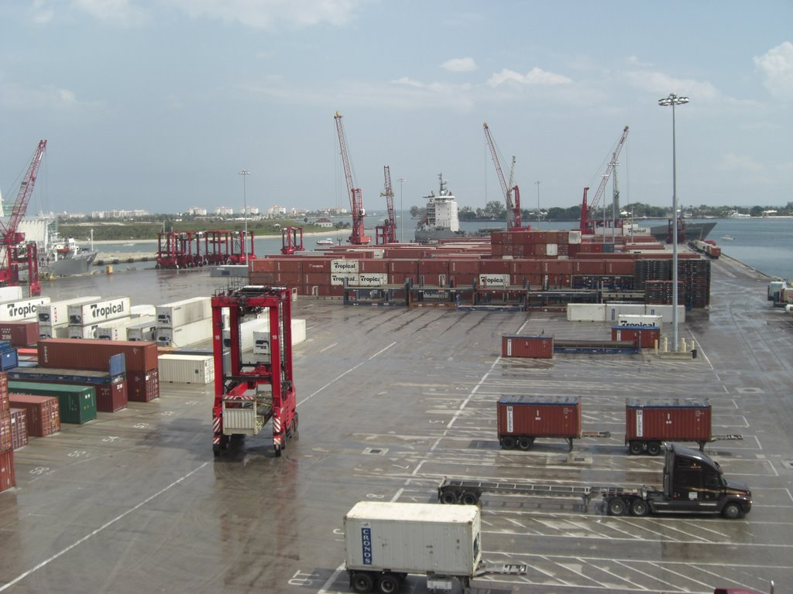
Ports: SE Florida Port System
Port of Palm Beach
Blue Heron Blvd/Port Stacking Mitigation
Slip 3 redevelopment and expansion – existing bulkheads in dire need of repair currently reviewing alternatives to rebuild and expand. Would allow for 2 additional ships to dock.
New Master Plan just underway
Port of Ft. Pierce
Taylor Creek Phase III fully
funded
Spoils site purchased and ready for final Phase of Taylor Creek Dredging
New Master Plan for the Port of Fort Pierce

Slide 16
Inland Ports: Proposed System
(Intermodal Logistic Centers)
Port Everglades ICTF
  42 acres of ILC
Hialeah Logistics Hub
  300 acres of Logistics Hub
Palm Beach County ILC
  255 acres of Intermodal Rail Yard
  8.82 million square feet of warehouse space
St. Lucie County ILC
  611 acres of Intermodal Rail Yard
  40 million square feet of intermodal campus, distribution center and mining.
Glades County ILC
  Similar footprint as St. Lucie County ILC
St. Lucie County ILC
Glades County ILC
Palm Beach County ILC
Hialeah Logistic Hub
POM
Notes:
Some is reliant on the outcome of the 27 study

Slide 17
South Florida Airport System
PBIA
Ft. Lauderdale
Port of Miami
Port of Key West

Slide 18
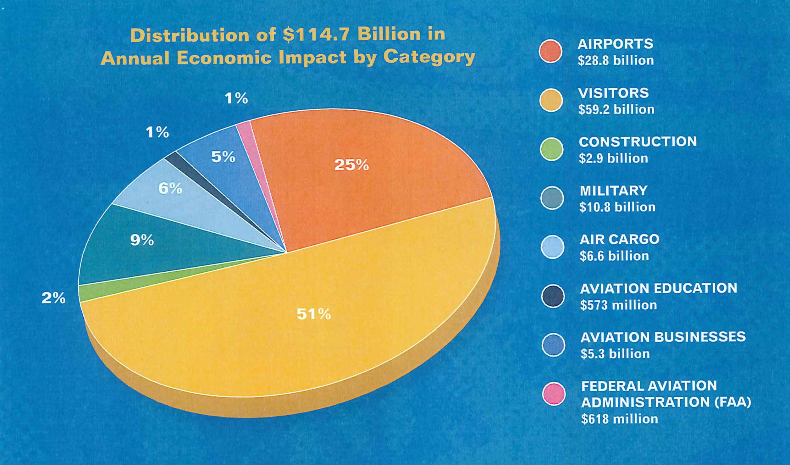
South Florida Airport System

Slide 19
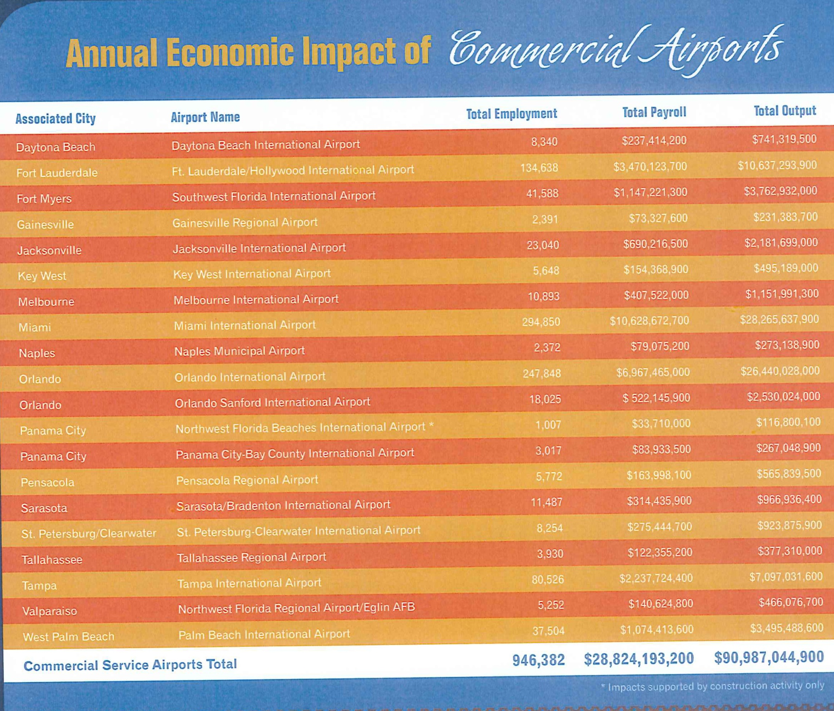


Slide 20
South Florida Airport System
The Challenges
Integrating Competition : Cargo vs. Passenger
Competition between airports in the region
Intermodal facilities – Does it make sense to have
cargo airport?
Connecting Airports to Transit
Aligning with the Airport’s Economic Prosperity
Vision

Slide 21
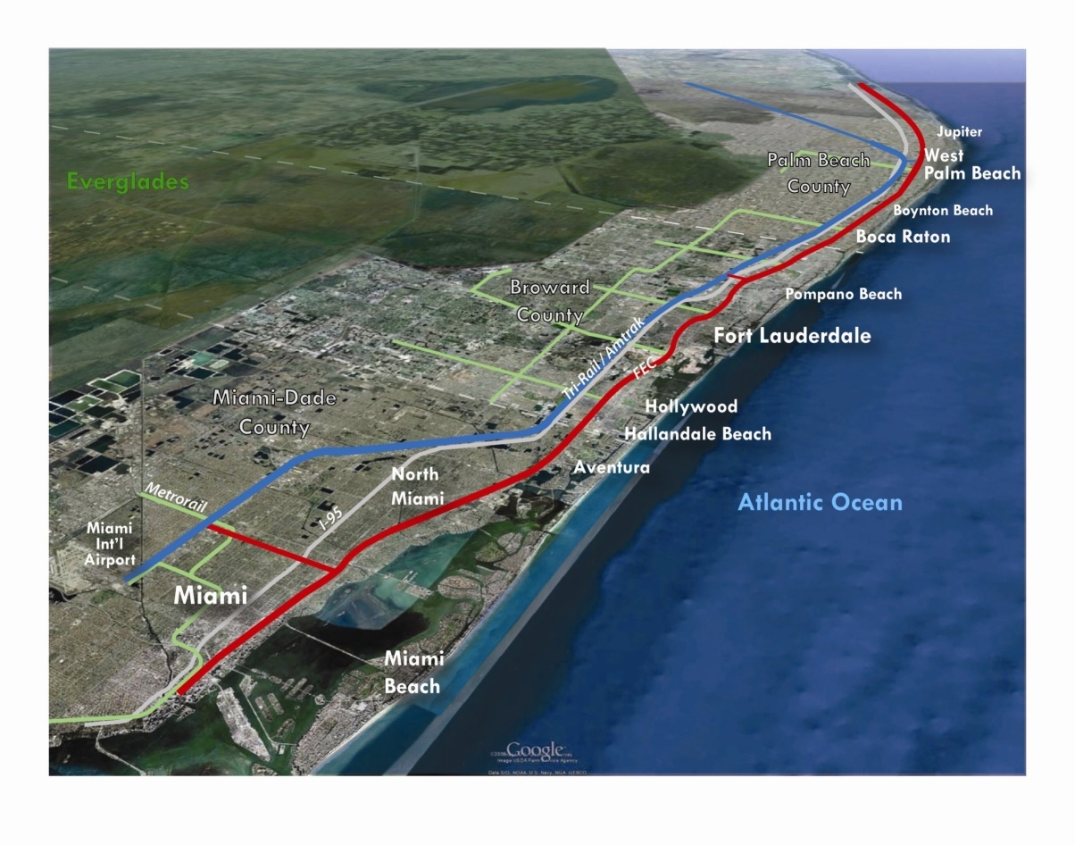
Re-introduce Passenger Rail Service on FEC Corridor (85 miles)
Enhance Mobility Options in Eastern Core Areas of 3 Counties
Create Conditions for Economic Growth and Redevelopment
Leverage Existing Rail System Infrastructure – Balance Passenger & Freight
Strengthen East-West Connections
SE Florida Passenger Rail:
The Goals

Slide 22
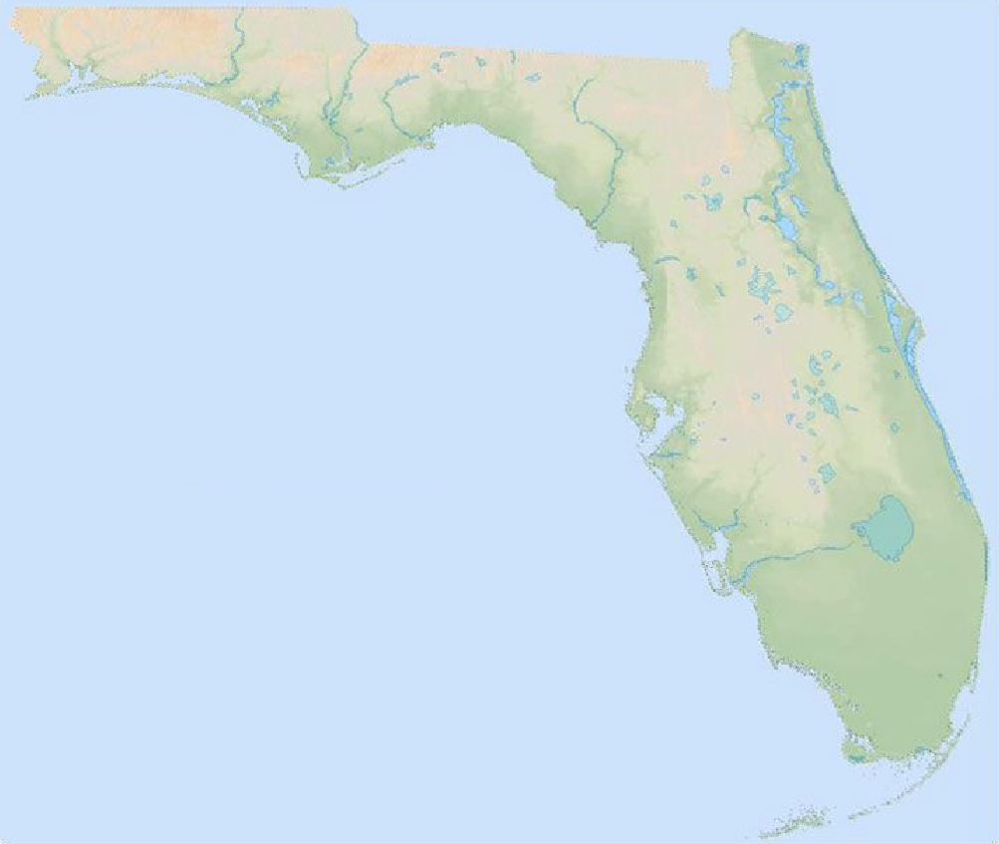
Passenger Rail
The Challenge: Dueling Proposals
FAST START
SFECC
Regional Rail Service
Jupiter to Miami
Connects to SFRC at Northwood, Pompano and IRIS
85 miles
Up to 52 stations in LPA
(under refinement)
First Phase to Ft. Lauderdale
Relying on Federal Funds
Integrated Service on the FEC
Jupiter to Miami
Connects to SFRC at, Pompano
85 miles
Up to 52 stations (modified Service and New Service)
Relying on Local Funds
Fast Implementation
Low Operating Costs
Ft. Pierce
Jupiter
Jupiter
West Palm
Beach
Pompano Beach
Pompano Beach
Fort Lauderdale
Miami
Miami

Slide 23
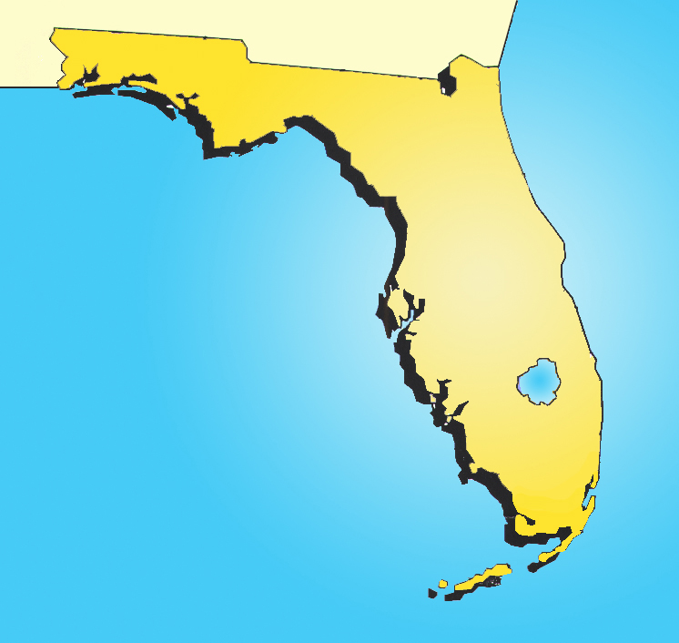

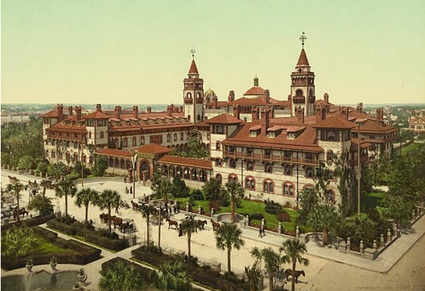
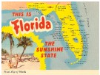
Jacksonville
Palm
Beach
Miami
CSX et.al.
FEC
Key
West
Notes:
1830s – 1880s – CSX tracks (Chessie & Seaboard – which was a series of merged rail companies)
1880s – Flagler began RR extension from Jacksonville south to St Augustine – then city-by-city to Miami in the late 1890s – then to Key West (the “Overseas Railway” in in 1912 (bridge to KW later was demolished in hurricane in 1935)

Slide 24
A Third Passenger Rail Proposal
FEC Amtrak Intercity Rail
FEC - Amtrak
86 stations from Miami to Key West
Jacksonville
Intercity Passenger Rail Service
JAX to Miami thru WPB;
Switches to SFRC at Northwood;
Terminates at Miami Int’l Airport
280 miles
8 New Stations
West Palm
Beach
The “Flagler Legacy”
Miami
Funding & Liability
Notes:
Flagler – Funding and Liability – Resolved this legislative session

Slide 25
Connecting Land Use & Transportation
The Challenge: Change the Culture, Create Quality Places
Stop Thinking so Suburban in our approaches to solving transportation.
Change the Culture of Thinking Among Those in Charge of Solving Our Transportation Problems

Slide 26
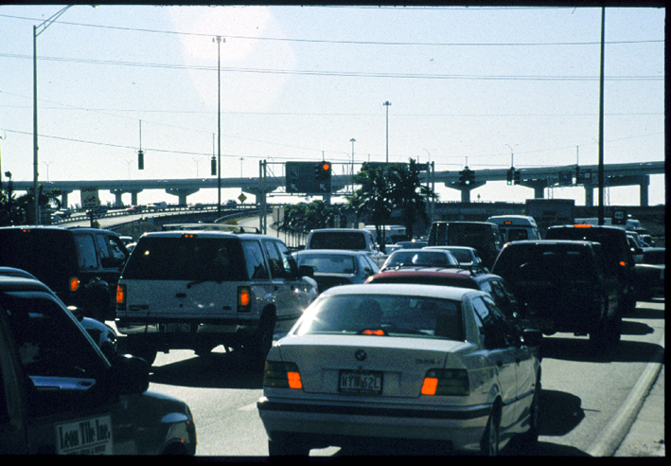
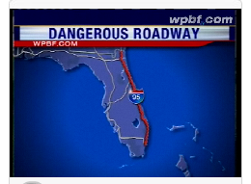
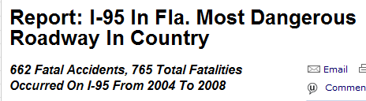
Lack of Integration: A Typical Commuter Trip

Slide 27
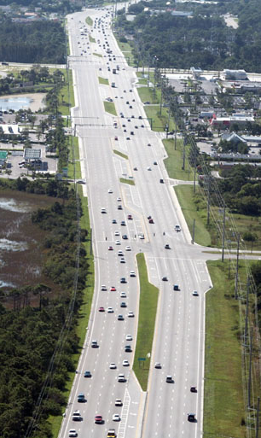
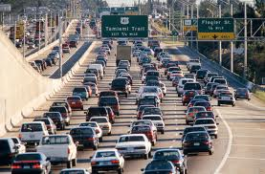
Land Use/Transportation Challenges
Southeast Florida’s congestion costs, based on wasted time and fuel, were approximately $3.3 Billion in 2009
Texas Trans. Inst., 2010 Urban Mobility Study
140 Million Hours wasted every year … just sitting in traffic

Slide 28
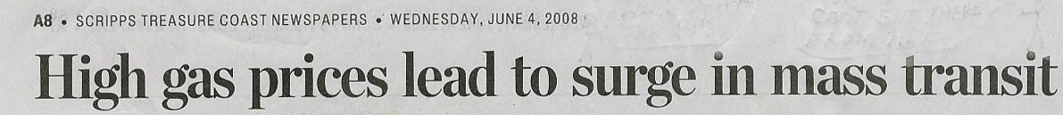
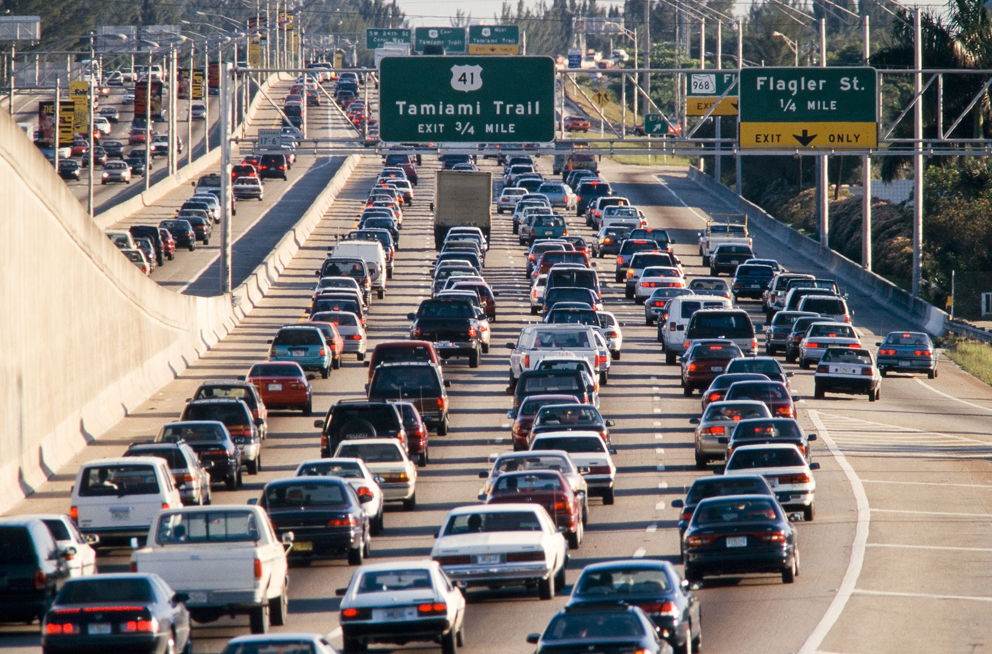
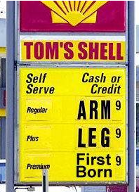
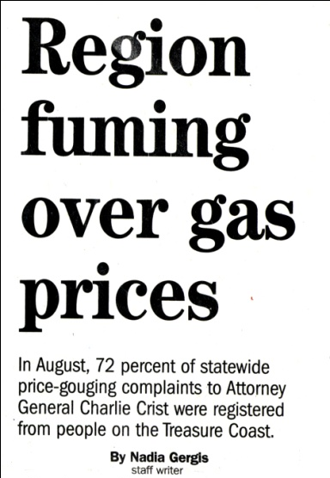
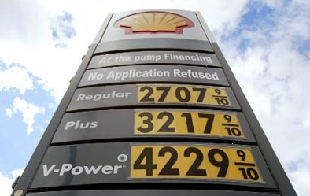
Virtual Present….Future Trend?
“Let our advance worrying become advance thinking and planning.”
-- Winston Churchill

Slide 29
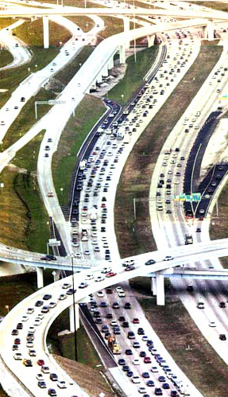

What’s the Roadway Forecast?
“I have 25% of the money I need to build 100% of the State’s Intermodal Highway System in District Four”
James Wolfe, FDOT Secretary, District Four
Notes:
FDOT’s 2060 Florida Transportation Plan, adopted in Dec 2010, indicates the state has a $53 Billion shortfall through 2035, which underscores the need for greater efficiency (and multi-modality) going forward for the state’s transportation network.

Slide 30
What’s the Roadway Forecast?
FDOT’s 2060 Florida Transportation Plan, adopted in Dec 2010, indicates the state has a $53 Billion shortfall through 2035, which underscores the need for greater efficiency (and multi-modality) going forward for the State’s transportation network.
“I have 25% of the money I need to build 100% of the State’s Intermodal Highway System in District Four”
James Wolfe, FDOT Secretary, District Four
Notes:
FDOT’s 2060 Florida Transportation Plan, adopted in Dec 2010, indicates the state has a $53 Billion shortfall through 2035, which underscores the need for greater efficiency (and multi-modality) going forward for the state’s transportation network.

Slide 31
SE Florida Transit
Monroe
Miami-Dade
Broward
Palm Beach
Martin
Saint Lucie
Indian River
Miami Urbanized Area
Port St. Lucie UA
Vero UA
MPO
MPO
MPO
MPO
TPO
MPO
Southeast Florida Transportation Council (SEFTC)
Treasure Coast Transportation Council
FDOT District VI
FDOT District IV
Rail Enterprise
Turnpike Enterprise
South Florida Regional Transportation Authority/Tri-Rail
Martin/St. Lucie
RTO
MDT
BCT
Palm Tran
MC Council on Aging
SLC Council on Aging
GoLine IRT
MDX
South Florida RPC
Treasure Coast Regional Planning Council
Local Governments

Slide 32
SE Florida Transit
The Challenges:
No service across County Lines
Limited connection coordination

Slide 33
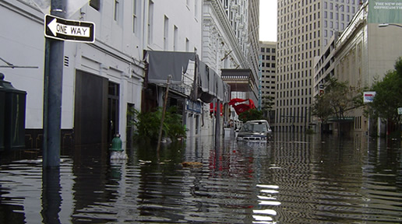
Sea Level Rise

Slide 34
High Speed Rail

Slide 35
The blueprint:
The Chance to Bring All the Different and Sometimes Uncoordinated Pieces of the Transportation Puzzle Together.
23 Transportation Planning Agencies, 7 Counties and 121
Towns and Cities
Freight & Goods Distribution: Rail, Ports, Inland Ports and SIS Systems
Commuter Rail: SFECC (FDOT) & NEW START (SFRTA)
Transit
Connecting LAND USE and TRANSPORTATION
Sea Level Rise
High Speed Rail
Consistent With The 2060 Vision for the Region

