Slide 1
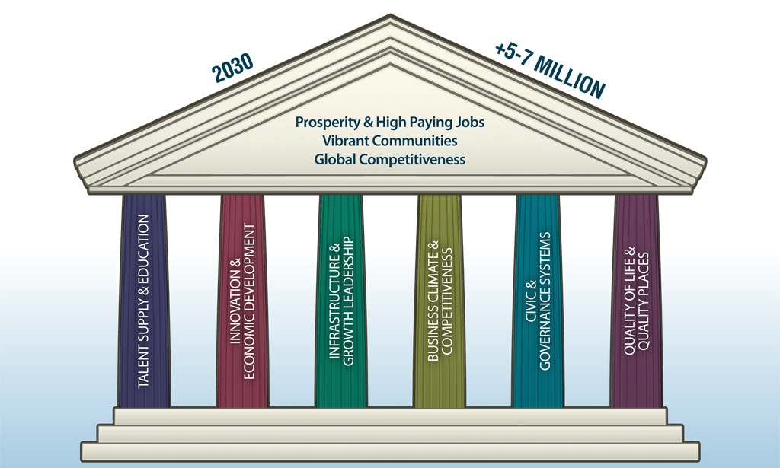
six pillars of Florida’s future economy

Slide 2
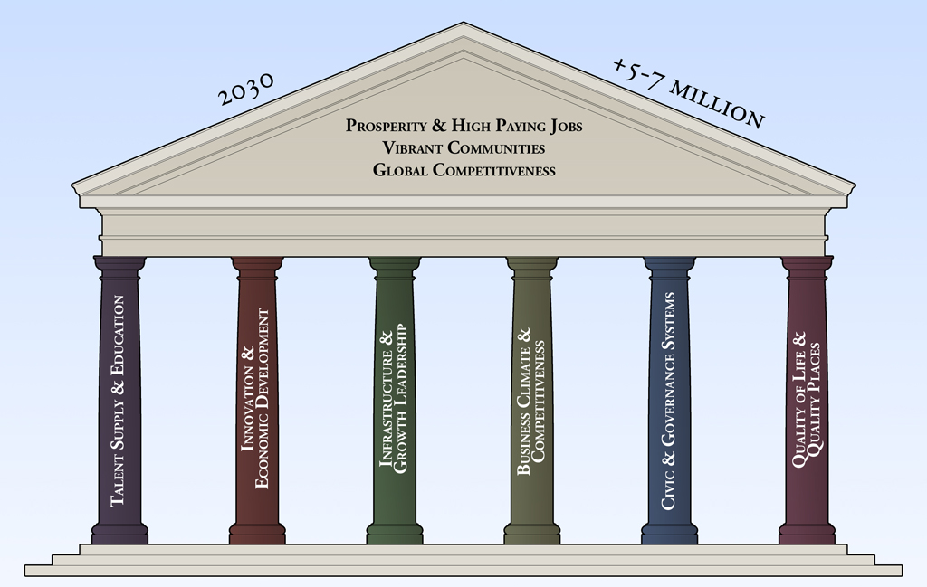
six pillars of Florida’s future economy

