Slide 1
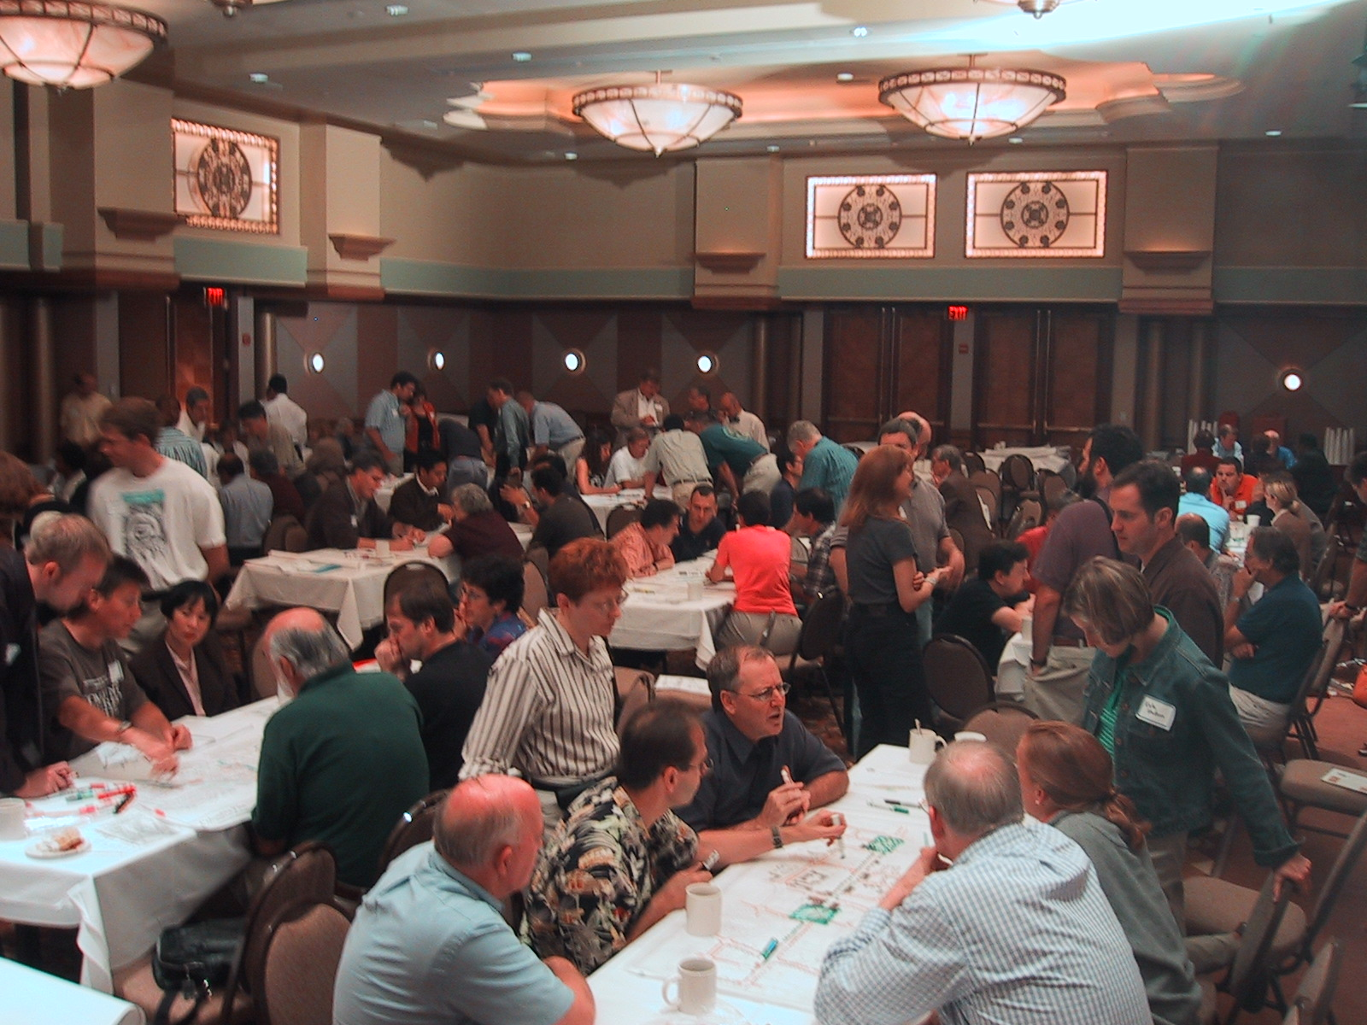
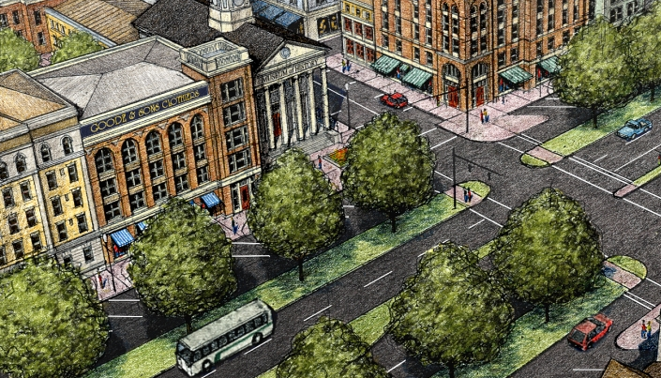
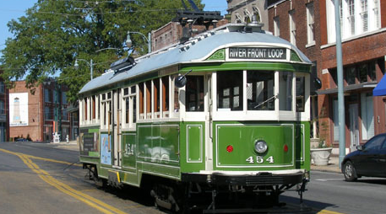
southeast florida’s regional vision
for economic prosperity
the blueprint
outreach
teamwork
experts
Notes:
1

Slide 2

2010
2011
2012
Q 1
Q 2
Q 3
Q 4
Q 1
Q 2
Q 3
Q 4
Q 1
SFRPC and TCPRC spearhead SCI Grant and Partnership is selected as an awardee
Cooperative Agreement with HUD (Feb. 21, 2011)
Revised Work Plan and Budget to HUD (April 22, 2011)
Scoping Phase
Task One: Building Collaborative Partnerships
Top-ranked Team Selection Process (June 2011 – January 2012
Request Statement of Qualifications (June 24th)
Dover Kohl selected as top-ranked team/negotiated contract (September 30th)
EC recommends approval by SFRPC (October 28th)
SFRPC approves lead team/Contract subject to HUD review (November 7th)
Execution of Master Consultant Contract (January 2012)

Slide 3
Process for Approval of SCI Grant Expenditures and Reimbursement Requests
U.S. Department of Housing and Urban Development
Executive Director of SFRPC
SFRPC Expenses
Consultant Expenses
TCRPC Expenses
Southeast Florida Climate Change Compact Expenses
Master Consultant Expenses
(Dover Kohl)
Sub-grant Consultant
Sub-grant Consultant
Sub-grant Consultant

Slide 4
Budget Performance
Salaries $191,077.61
Fringe Benefits (allocated) $48,172.07
Travel Reimbursements $7,975.35
Printing, Notices and Advertising $559.90
Communication and Postage $4,020.29
Consultant Expenses $5,000.00
Indirect Costs $206,383.43
Direct expenditures by SFRPC $463,188.65 (Through Dec 2011)
Direct expenditures by TCRPC $141,558.88
(Through Dec 2011)
HUD-reimbursed expenditures $604,747.53 (Feb 2011 – Dec 2011)

Slide 5
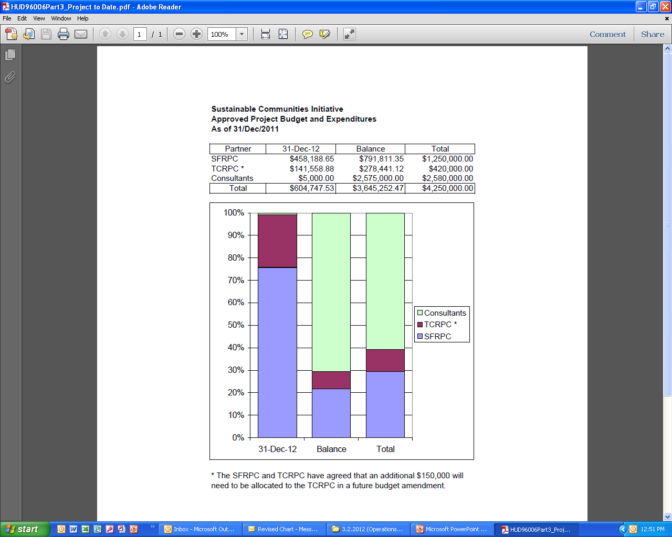

Slide 6
Partnership Staff (SFRPC)
Direct charge of 3,711 hours (44 weeks)
Current annual salaries at SFRPC range from $30,900 to $160,000
Estimated total 3-year indirect cost is $560,960 (89.2% on salary and fringe)
Percent of time of one FTE dedicated to the project:
Executive Director/ 747 42% Project Director
Isabel Cosio-Carballo 1,428 81%
Eric Swanson 512 29%
Richard Ogburn 312 18%
Jeanne Tan 216 12%
Other Program/ 86 6% Policy Staff
Support Staff 410 23% (Admin, Graphics, IT)

Slide 7
Partnership Staff (TCRPC)
Direct charge of 476 hours (44 weeks)
TCRPC contracted with Marcela Camblor as the Program Manager for region’s role in the grant.
  $129,000 annual contract plus $1,000 monthly travel
  Total paid on this contract = $69,461.56
  (Through Dec 2011)
The SFRPC and TCRPC have agreed that an additional $150,000 will need to be allocated to the TCRPC in a future budget amendment
Percent of time of one FTE dedicated to the project:
Michael Busha 249 12.7%
(Executive Director)
Kim Delaney 166.5 18.5%
Greg Vaday 15.5 0.8%
Liz Gulick 45 2.3%
(Administrative Supervisor)
Marcela Camblor
(Program Manager)

Slide 8
Budget / Work Plan Next Steps
Convene Management Team meeting following March 2nd Operations Subcommittee Meeting
Review April 21, 2011 Project Work Plan and Tasks
Revise proposed Work Plan, Timeline and Budget with additional task detail for review by SCI Executive Committee and HUD (Assign task responsibilities SFRPC, TCRPC, Consultant Team, Consortium Partners, Subgrantees as needed.
Convene Operations Subcommittee for review of updated work plan, timeline and budget
Review with SCI Executive Committee on March 30, 2012

Slide 9
2012
2013
2014
Q 1
Q 2
Q 3
Q 4
Q 1
Q 2
Q 3
Q 4
Q 1
Task 1: Building Collaborative Partnerships
Task 2: Regional Resource Library and Scorecard
February 2014
Task 3: Conducting Public Engagement
Task 4: Enhancing Regional Leadership and Technical Capacity
Task 5: Developing Regional Vision
Task 6: Developing Blueprint
& Implementation
Primary Tasks

Slide 10
2012
2013
2014
Q 1
Q 2
Q 3
Q 4
Q 1
Q 2
Q 3
Q 4
Q 1
Task 1: Building Collaborative Partnerships
1.1 Continue Developing Regional Partnership
February 2014
1.2 Identify Opportunities to Enhance Collaboration
1.3 State and Regional Coordination
1.4 Strategies for Regional Collaboration
1.5 Expand Participation
1.7 Continue Developing Regional Partnership
Task 1 items are being performed by the RPCs

Slide 11
2012
2013
2014
Q 1
Q 2
Q 3
Q 4
Q 1
Q 2
Q 3
Q 4
Q 1
Task 2: Regional Resource Library and Scorecard
2.1 National Research
2.2 Survey and Integrate Regional Values
2.3 Data Warehouse
February 2014
2.4 Demographic Forecasts
2.5 Regional Housing Assessment
2.6 Virtual Present
2.7 Existing Conditions Analysis and Modeling
2.8 Trend Future
2.9 Model Trend
2.10 Develop Regional Indicators for Scorecard
2.11 Select Indicators for Scorecard, Review w/ Exec. Committee
2.12 Integrate Scorecard Indicators in Model
2.13 Ongoing Monitoring

Slide 12
2012
2013
2014
Q 1
Q 2
Q 3
Q 4
Q 1
Q 2
Q 3
Q 4
Q 1
Task 3: Conducting Public Engagement
3.1 Create Outreach & Engagement Strategy
February 2014
3.2 Refine & Implement Outreach Strategy
3.3 Web Site & Template Materials (including Regional Scorecard)
3.4 Regional Values Polling
3.5 Regional Scenario Workshops & Summits
Regional Summit – Peer Regions
Regional Summit – Existing Conditions and Trend Future
Regional Summit - Where Do We Want To Go?
Regional Summit – Preferred Scenario - How Do We Get There?
Regional Summit – Regional Vision Adoption
3.6 Develop a Speakers Bureau

Slide 13
2012
2013
2014
Q 1
Q 2
Q 3
Q 4
Q 1
Q 2
Q 3
Q 4
Q 1
Task 4: Enhancing Regional Leadership and Technical Capacity
4.1 Develop Capacity-Building Strategy
February 2014
4.2 Asset Mapping
4.3 Develop Regional Leadership Program
4.4 Best Practices
Task 4 items are part of the Public Engagement Phase

Slide 14
2012
2013
2014
Q 1
Q 2
Q 3
Q 4
Q 1
Q 2
Q 3
Q 4
Q 1
Task 5: Developing Regional Vision
5.1 Develop Workshop Framework and Content
5.2 Workshop Training w/ Partners
February 2014
5.3 Regional Workshops
5.4 Compile & Analyze Workshops Results
5.5 Create Alternative Future Scenarios
5.6 Evaluate Model Scenarios, Present Findings
5.7 Outreach Program and Regional Dialogue
5.8 Choose and Model Preferred Scenario
5.9 Create Vision Plan
Task 5

Slide 15
2012
2013
2014
Q 1
Q 2
Q 3
Q 4
Q 1
Q 2
Q 3
Q 4
Q 1
Task 6: Developing Blueprint
& Implementation
6.1 Develop Vision Framework
6.2 Develop Blueprint Integration Strategy
February 2014
6.3 Identify Paths to Implementation
6.4 Vision Adoption
6.5 Integrate Regional Blueprint into Strategic Planning
6.6 Identify, Scope & Implement Demonstration Projects
6.7 Create a Regional Tool Box
6.8 Refine and Update Regional Blueprint
Task 6

Slide 16
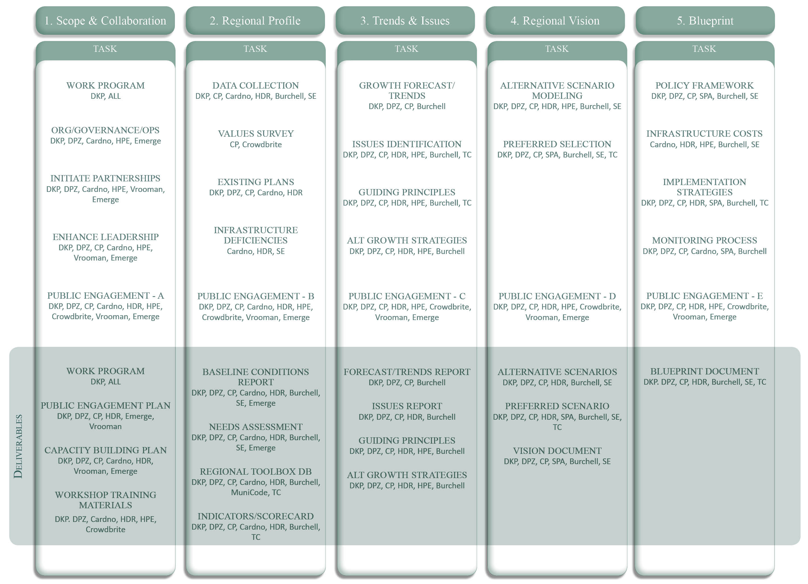
Notes:
We have a work plan we have refined further since the submittal of the SOQ which we can come back to and discuss later. Suffice to say we have a plan for every task…
This is just a rough outline and we look forward to working with the committee on this
16

